Slide 1
Assignment 1
Ubiquitous Computing Lab
Suryasaradhi Balarkan 1840580

Slide 2
Problem Statement
A surfing assistant device attached to a surfboard, the device will track and analyse the position of the surf board while a rider surfs and give insights on how the user is surfing using AI.

Slide 3
Methodology
By Fusing GPS and IMU sensor (Accelerometer Gyroscope and Magnetometer data) estimate position in 3D Space
Use a pressure sensor to detect pressure applied by the rider on the board
Sent recorded data to an Android app where the AI resides.
Use AI algorithms to compare trained good surf rides against the user’s current ride.

Slide 4
Hardware Selected
Wifi + Bluetooth + Multicore + >1MB Ram + Power Efficient + SPI + I2C : ESP32 S3 Wroom 1 (16MB flash , 2MB Ram, 2 core)
9 Axis Precise IMU : NXP-9 IMU (Very low noise)
Small Precise low powered GPS : ZOE M8Q
SDCard adapter : SPI SDCard Module
Battery Power Management : AXP2101 (Includes USB PD)

Slide 5
Process flow on Hardware
Start
GET IMU data
Store as CSV on SDcard
GET GPS data
Calibrate
GET Pressure Sensor data

Slide 6
Process flow on PC
CSV Data on Sdcard
Sensor fusion of GPS with IMU
Feed Generated 3D space data to AI
Align all timestamps of data
Use Madgwick Algorithm to estimate quartenions
Show AI Suggestions

Slide 7
Issues while Implementing
Sensor fusion with madgwick algorithm is not promising in the z direction. As GPS doesn’t provide reliable Z height , we can only rely on double integration of IMU to get Z height ,this can be overcome using a barometer
Drift while using IMU to calculate position
Getting accurate Kalman filter gains for Sensor fusion
Noise in IMU data
Polling rate of GPS and IMU data are different , so the implementation needed timestamp based interpolation
Simultaneous data sampling from all sensors while writing to SD card was causing jitter in system

Slide 8
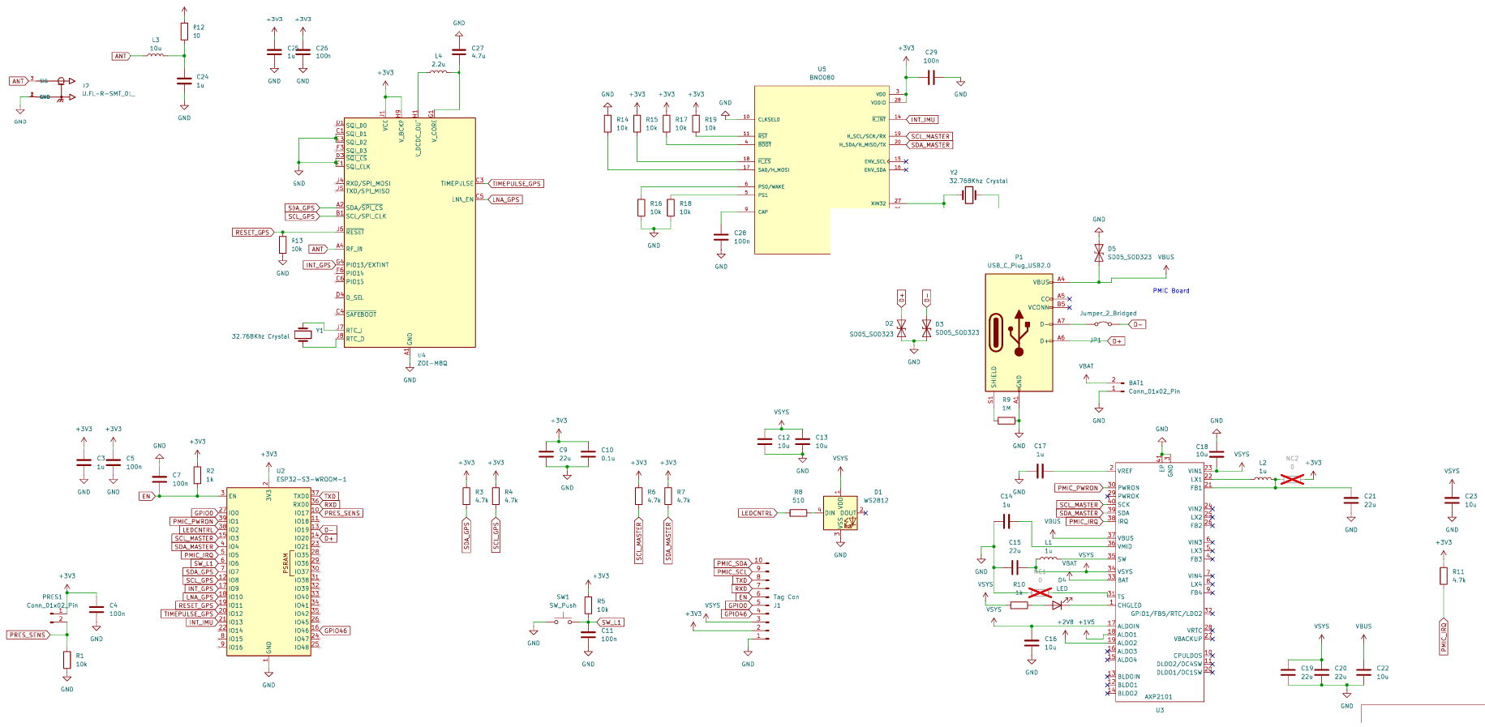
Implemented Schematic

Slide 9
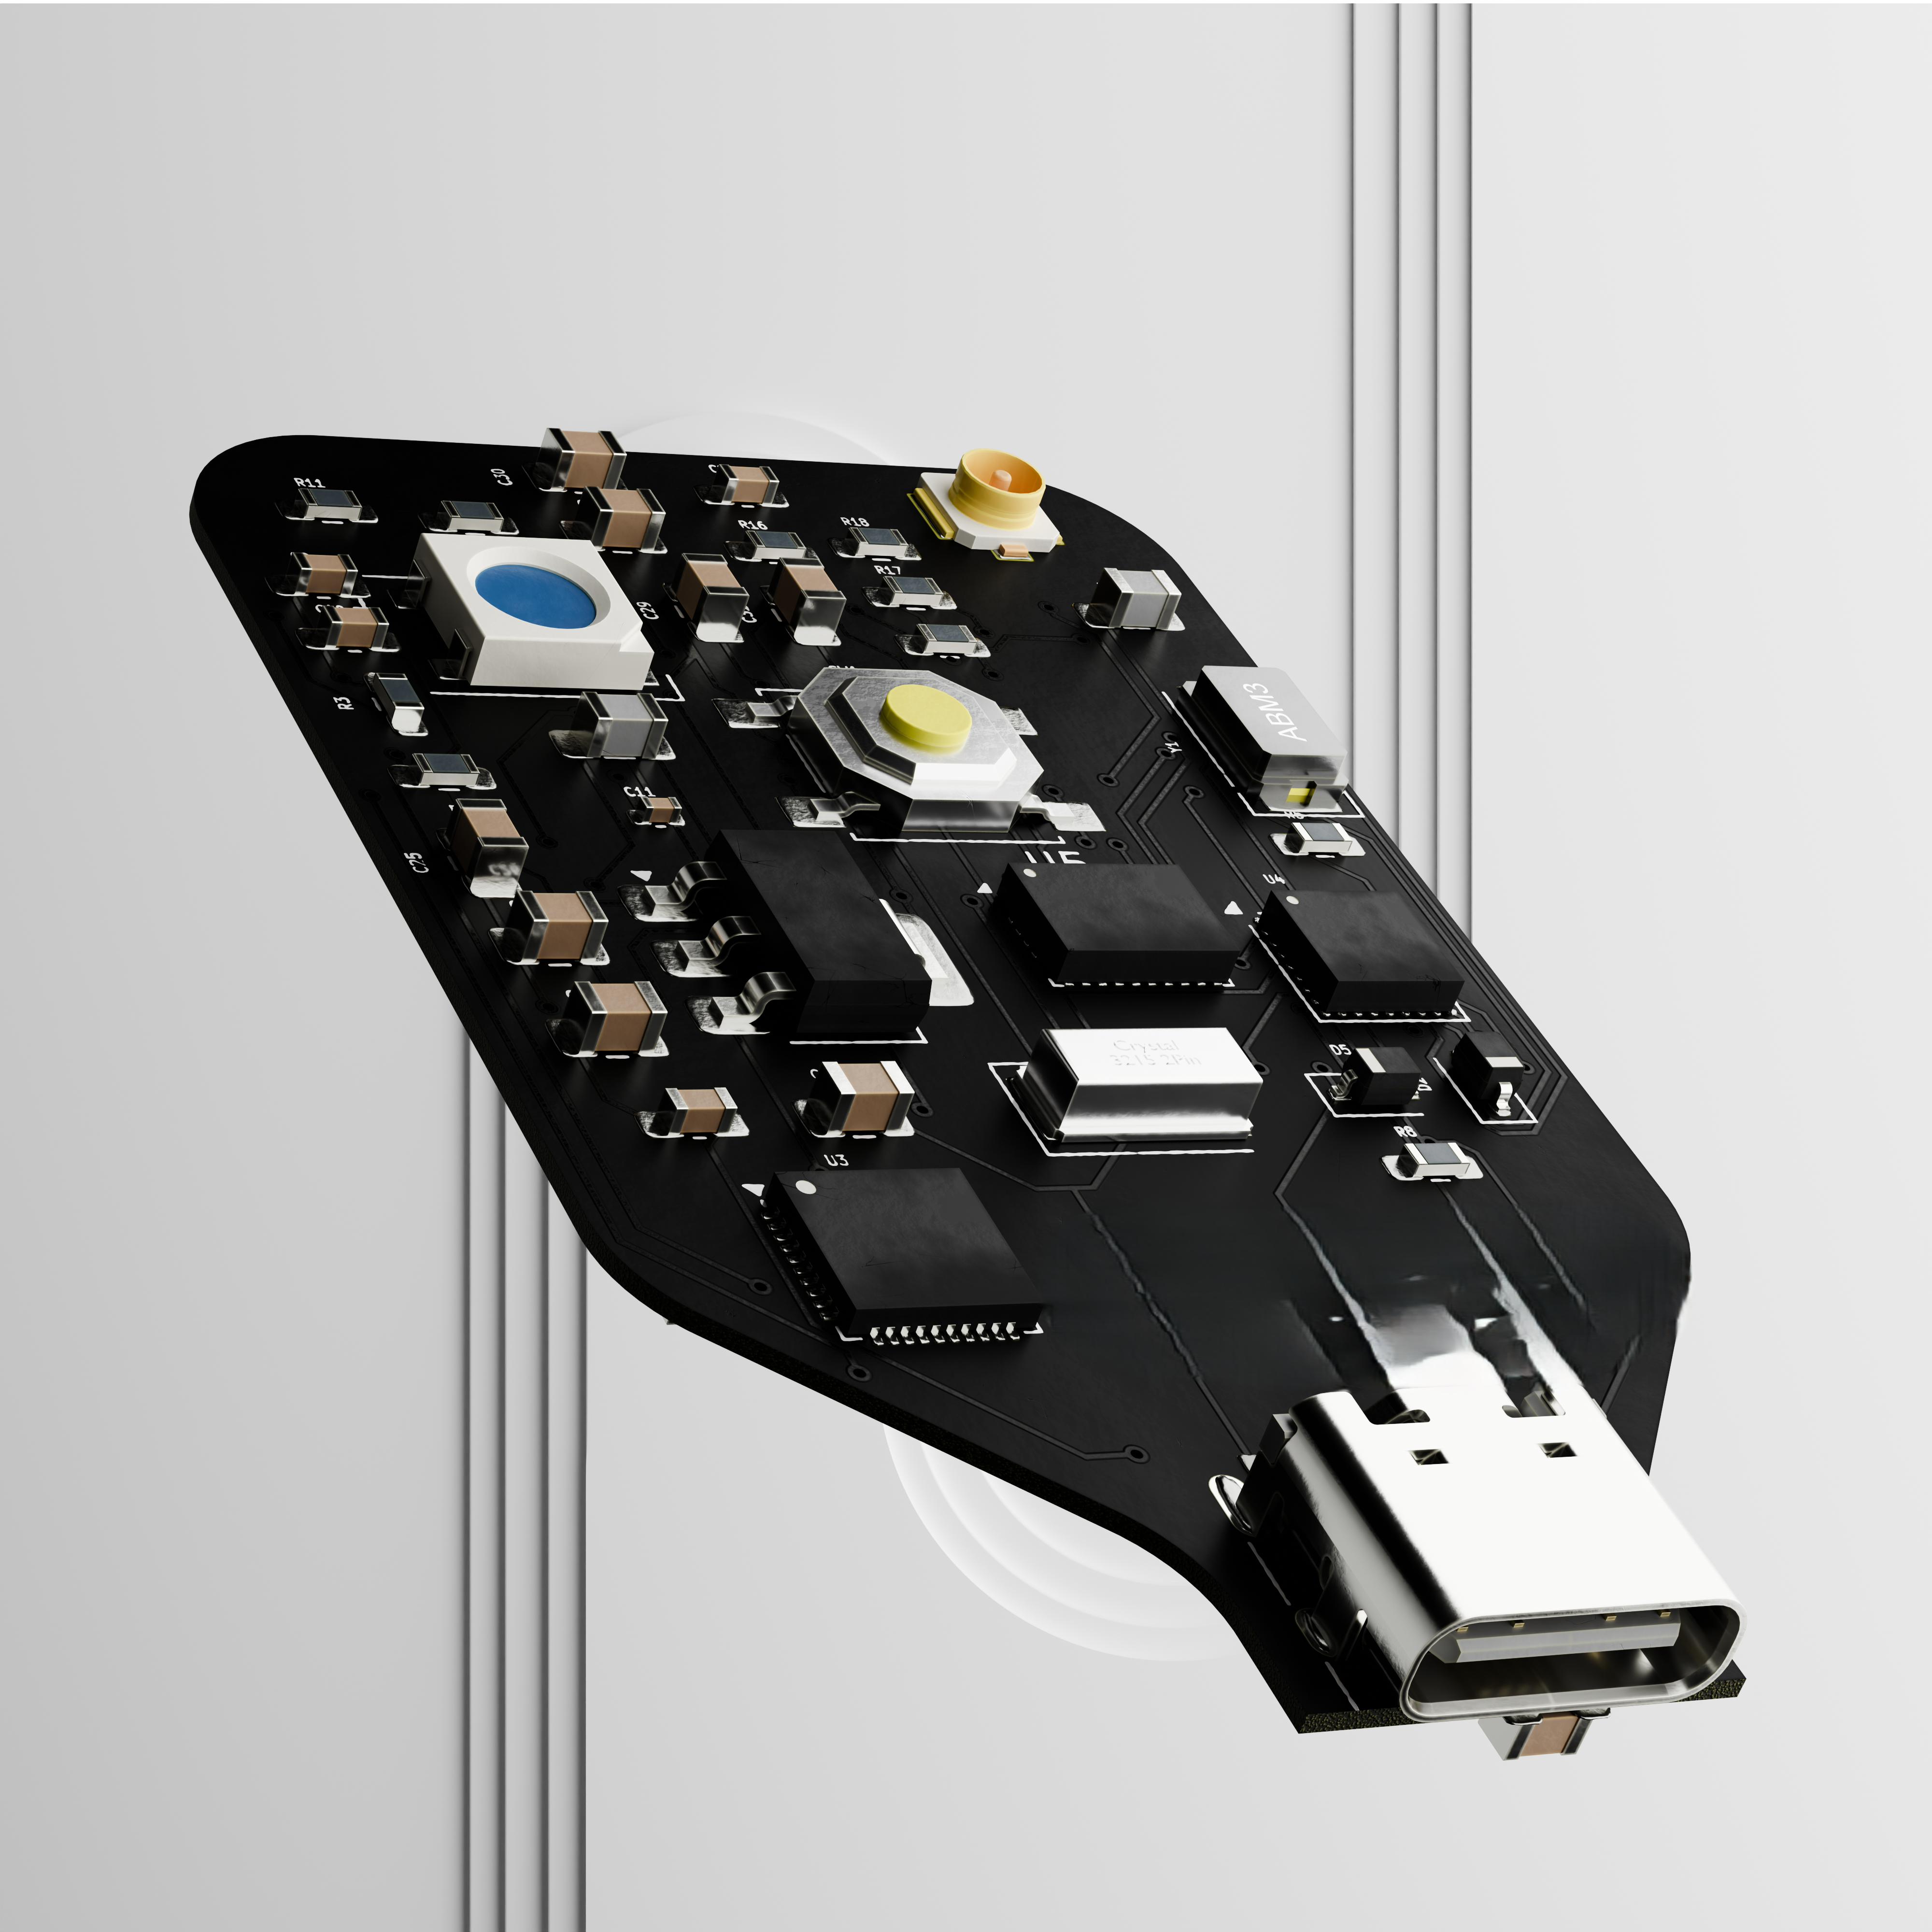
Proposed Device – Realistic Render

Slide 10
Initial Prototype Design Goals
IMU data (A/G/M) save to sdcard
GPS data to Sdcard
Pressure sensor data to sdcard
Simultaneous Data processing (Multithreaded)
Sync all data points in time
Sensor fusion and plot data in PC

Slide 11
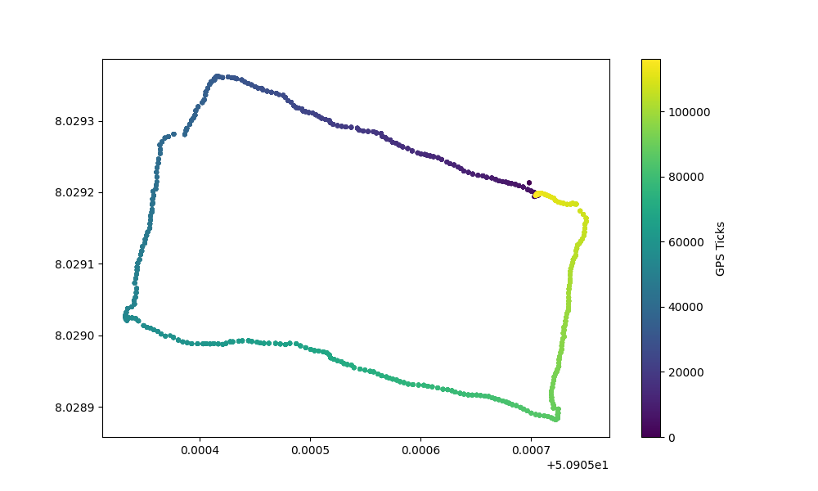
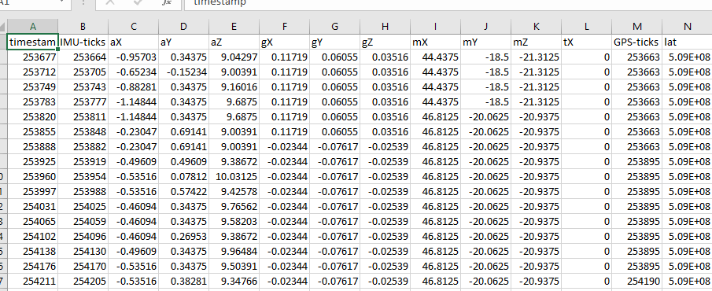
Demo Plot and data
Data saved by the device
Position Data Plotted from the device
( IMU + GPS fusion)
Rectangular Walk Across Elab Ground

Slide 12
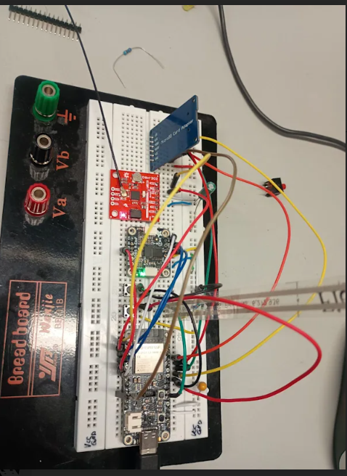
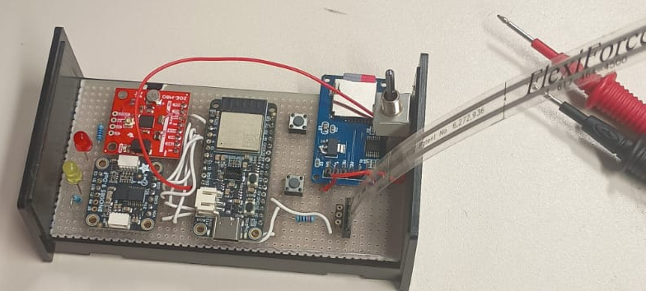
Demo Device
The wearable will be fabricated from JLCPCB
Prototype v1
Prototype v2

Slide 13
Tools Used
Sublime IDE
Cmake
C++ build systems
Python,Rust
Kicad
Proteus
Fusion 360
C#
Dart, Android Studio

Slide 14
Github Repo
https://github.com/thesunRider/APMWS/tree/master/assign/ubq1

Slide 15
THANK YOU
The project is commercial and owned by myself

